Slide 1
EFD Classification and Ideas for sem app
Vladimir Alexiev, Ontotext 20 Mar 2015, Athens

Slide 2
Outline
Classification Purpose and Semantic Enrichment
The Classification Problem
FD Classification Examples
Candidate Datasets
Visualizations
Tool Ideas

Slide 3
Classification Purpose and Semantic Enrichment

Slide 4
FD Classification Purposes
Classification of content provided by the EFD project partners
Enable semi-automatic enrichment of content assets and their associated metadata
Enable discovery & classification of content already existing in Europeana that is also related the topic of interest (390k to 3.9M objects!)
Form the basis for a future Food and Drink Channel on Europeana, a goal that the EC has posited
Provide the core semantic information underpinning the Semantic Demonstrator application
Enable semantic search and faceting
All this in a widely (wildly?) multilingual context:
EN, 5 bilingual, 5 monolingual

Slide 5
Why Semantic Enrichment
Semantic enrichment: "things not strings": tease meaning out of text.
Semantic entities/concepts have additional useful information:
Part of a meaningful hierarchy, e.g.:
Chicken is Meat
Pestle is <grinding and milling equipment>, together with grinders, mortars, grindstones, manos, and (according to Getty AAT) sausage stuffers
Austral Islands is in French Polynesia
Christmas Bread is a kind of Christmas food
Bread Loaf is a type of bread
Bread Loaf is associated with Bulgarian Cuisine
A lot of these have additional information, e.g.
Bulgarian Cuisine is made/used in Bulgaria
Austral Islands has coordinates S 23° 0' 0'', W 150° 0' 0''
Bread is mostly made of grains

Slide 6
Semantic Search
Semantic enrichment enables powerful search & exploration:
By concept (with all alternative and multilingual labels)
Concept hierarchy (query expansion, see next)
Geospatial (within rectangle or near a place)
Faceting (by object type, food or ingredient type, location etc)

Slide 7
Query Expansion
If I search for a concept, I want to find all sub-concepts
Query expansion for "beer" in 6 languages
beer OR "Beer" OR "Öl" OR "Cerveza" OR "Birra" OR "Bier" OR "Bière
Mere word translation does not:
Accommodate hyponyms, e.g. Lager or Pilsner
Deal with ambiguity. E.g.
Recipe → food or Medicine?
Fork → eating (cutlery), agricultural instrument (pitch fork), musical device (tuning fork)?
"Poisonous India" article criticizing naïve early Europeana approaches
Objects were enriched with the term "poison" and its multilingual equivalents
In Latvian "poison" is "Inde"
A French-speaking Swiss domain expert added keyword "Inde" to objects about India
So searching for "poison" finds Indian movie covers and photos!

Slide 8
Enrichment Task Forces
In response to these problems, Europeana formed two task forces:
Multilingual enrichment strategy (2014)
Enrichment best practices and evaluation (2015)
Ontotext participates in both
Key strategic need for Europeana:
How to make sense of 39M objects and find relevant ones?
Europeana needs to turn Quantity into Quality
(BTW, a key principle in Dialectics)

Slide 9
Classification Concepts
Object types
Objects that appear in any museum or gallery: photograph, still life, painting (Getty AAT)
FD-specific and Agricultural objects: containers, vessels, dishes, cutlery, field-work instruments (e.g. ploughs), objects made of food, etc
Agricultural and FD-related tools used as depicted subject
Foods and Drinks: extensive lists of foods, varieties, brands, styles
Used as material
As depicted subject
Food ingredients and materials. Allows search by ingredient (e.g. maize) or class of ingredient (e.g. grains)
Activities related to FD and agriculture, e.g. eating, formal dining, bar-hopping, fasting, feasting, degustation, shepherding, ploughing, cooking, boiling, simmering
As depicted subject
As qualifier of the object
As qualifier of the food (e.g. cooking technique)
Person types related to FD, e.g. chefs, brewers, vintners, barista…

Slide 10
Classification Entities & Facets
Places (for geospatial or place-hierarchy search)
Relation: Made, Used, Found, Subject
People/Organizations
Relation: Creator, other Production role (painter, engraver…), Subject, Made For / Used By
Events
FD related events/festivals, e.g. beer fests, food fairs, Tomatina, etc
Religious holidays, e.g. Easter, Christmas, Pentecostal fast. Relation to FD, e.g. Christmas foods, Easter foods, food during fasting
Festivities, customs, traditions, holidays related to Food
Historic and remembrance days, e.g. World War I, Independence Day celebrations, Boston Tea party
Human life events, e.g. weddings, christenings, funerals
Agricultural work cycles/festivals, e.g. crop harvest, Autumn olive gathering
Culture/Period/Style
Getty AAT (5.5k). So far only wiki:Nyangatom not found in AAT

Slide 11
The Classification Problem

Slide 12
Specialist Thesauri
ECLAP (Performing Arts) vocabulary
Collected by the partners
Small: 10 classes, 90 properties
PartagePlus (Art Nouveau) thesaurus
Inspired by Getty AAT
Gathered by the partners
Majority of concepts (97%) successfully matched to AAT
Specialist areas call for focused small classifications
Does the consortium want to develop a specialist thesaurus??? Maybe on "EFD Themes"

Slide 13
Variety of FD Content
books on Bovine care & feeding (TEL)
book on tubers/roots used by New Zealand aboriginals (RLUK)
self-portraits involving some food (Slovak National Gallery)
traditional recipes for Christmas-related foods (Ontotext)
colourful pasta arrangements (Horniman)
mortar used to mix lime with tobacco to enhance its psychogenic compounds (Horniman)
food pounder cut from coral, noted for its ergonomic design (Horniman)
a composition of man with roosters/geese made from bread (Horniman)
horse made from cheese (Horniman)
poems about food & love
photos of old people having dinner
photos of packers on a wharf
photos of Parisian cafes
photos of a shepherd tending goats
photos of a vintner in his winery
medieval cook book (manuscript)
commercial label/ad for consomme
etc etc

Slide 14
The Classification Problem
Food and Drink is pervasive both in our daily lives, and also in our culture
The FD Classification will necessarily be very wide
Cannot be a closed "finished" artifact
Will be open-ended, ever evolving
Developed through human-computer interaction and positive feedback loops:
Machine Learning
Crowd-sourcing
Hoping that Europeana will adopt it and evolve it for the future FD Channel

Slide 15
FD Classification Examples

Slide 16
Classification Examples
In the examples below we use concepts/entities from Wikipedia, Getty Art & Architecture Thesaurus, and GeoNames
Each of the concepts/entities is available on the web and has additional data (categories/hierarchy, dates, coordinates…)
Wikipedia is available as machine-readable data: 11 DBpedias, Wikidata (see later)
We cover several classification facets; let's try to add more together

Slide 17
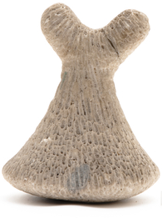
Coral Food Pounder
Object: aat:300024725 pestles
wiki:Mortar_and_pestle is similar, but is a group of 2 objects
Wikipedia is an encyclopaedia not dictionary
Wiktionary is a dictionary, but has smaller coverage
Material: aat:300250925 corals (animals)
Same as: wiki:Coral
Style/Period: aat:300021975 Austral Islands
Spatial (made and used): wiki:Austral_Islands
Same as: tgn:1009851 Îles Tubuaï
Same as: geonames:4033250
Penu is the type of pestle not a place
(Geonames knows 10 "Penu", but neither in the Austral Islands)

Slide 18
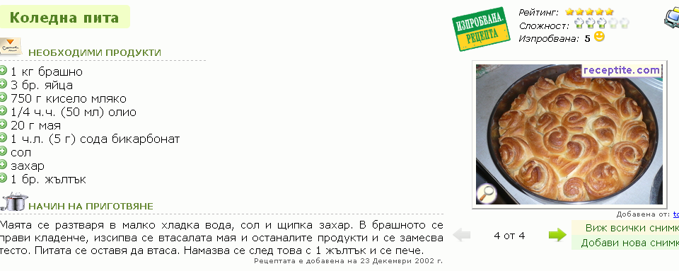
Christmas Bread
Object: aat:300027043 recipes
Same as: wiki:Recipe
Subject (food): enwiki:Česnica (Serbian)
Same as: ruwiki:Рождественский_хлеб (Russian)
Same as: ruwiki:Погача (Bulgarian)
Spatial (used):
Bulgaria & Macedonia (погача, пита)
Serbia (чесница)
Greece (basilopitta)
Event: wiki:Christmas

Slide 19
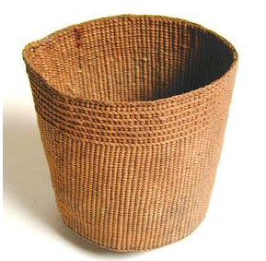
Woven Drinking Cup
Object: wiki:Cup
Same as: aat:300043202 cups (drinking vessels)
Material: ???
Spatial (made, used): wiki:North_America
Same as: tgn:7029440 (North America)
Technique: wiki:Weaving
Same as: aat:300053642 weaving
Culture/Style: aat:300017442 Native North American styles

Slide 20
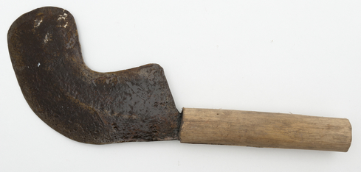
Machete
Object: wiki:Machete
Spatial (made, used): wiki:Belgian_Congo
Culture/Style: wiki:Mbuti_people
Same as: aat:300260713 Mbuti (Pygmies of Zaire)
Material: wiki:Iron, wiki:Wood

Slide 21
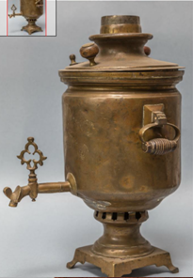
Samovar
Object: wiki:Samovar
Subject (used for): wiki:Tea
Material: wiki:Copper
Spatial (made, used): wiki:Russia

Slide 22
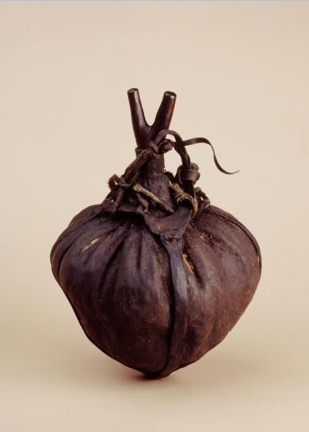
Butter Pot
Object: ???
Subject (made for): wiki:Butter
Materials: wiki:Wood, wiki:Leather
Material (origin): wiki:Camel ("preferably from the knee"), wiki:Ox
Spatial (found) wiki:Omo_River (Ethiopia)
Same as: geonames:8692910.
TGN doesn't have such entry
Culture/style: wiki:Nyangatom_people
Surprisingly AAT doesn't have such entry (also searched for the alias Donyiro)

Slide 23
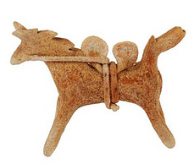
Cheese Horse
Object : wiki:Doll, wiki:Figurine
Spatial (made, used): wiki:Poland
Subject (depicted): wiki:Horse
Material: wiki:Cheese
Yes, really: http://www.horniman.ac.uk/get_involved/blog/keeping-food-in-our-collections

Slide 24
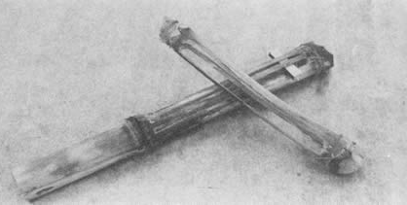
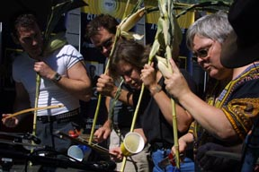
Cornstalk Fiddle
Object: wiki:Cornstalk_fiddle
Classification: String instruments, Bowed instruments, Maize products
Material: wiki:Maize
Spatial (use): wiki:United_States, wiki:Serbia
What??
Left: Cornstalk Fiddle Sextet ;-)
"Cotton Eye Joe" folksong: "cornstalk fiddle and a shoestring bow"
Paul Laurence Dunbar's poem The Corn-Stalk Fiddle

Slide 25
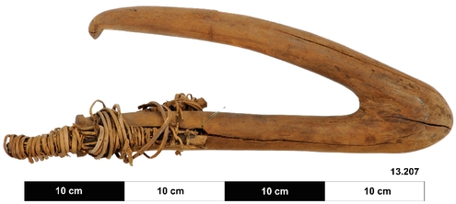
Shark Hook
Object Type: wiki:Fish_hook
Subject (used on): wiki:Great_White_Shark (judging from the size, 50cm)
Spatial (made, used): wiki:New_Britain
Material: wiki:Wood

Slide 26
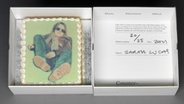
Cake-Sculpture-Painting
Creator: ulan:500115024 Lucas, Sarah (English sculptor, installation artist, and photographer, born 1962)
Object: wiki:Cake, wiki:Sculpture, wiki:Painting
Material/Technique:
wiki:Inkjet_printing
wiki:Fruitcake
ulan:300215468 cartons (containers)
Similar to: wiki:Cardboard_box
Yale Center for British Art

Slide 27
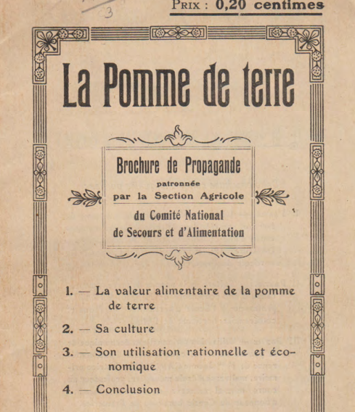
Compère - La pomme de terre
Object: wiki:Brochure
Extent: 14 pages
Spatial (made/used): wiki:France
Org (creator): wiki:Comité_National_de_Secours_et_d'Alimentation
Subject:
wiki:Potato
wiki:Propaganda
wiki:World_War_1

Slide 28
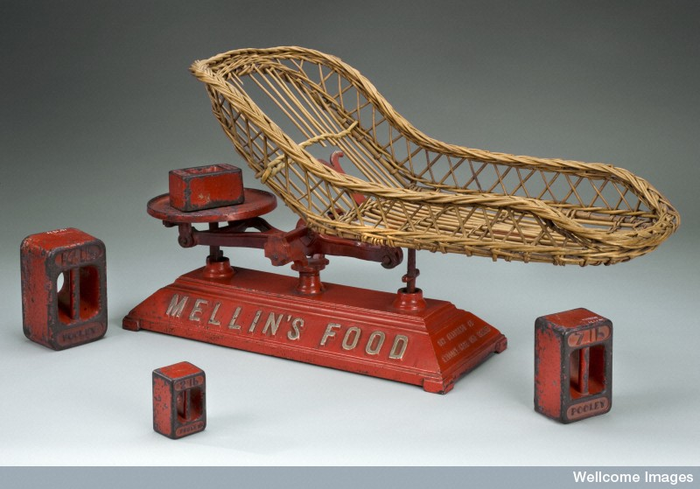
Weighing Machine for Infants
Object: wiki:Weighing_scale
Subject: wiki:Infant
Spatial (made): wiki:England
Org (creator): wiki:Henry_Pooley_&_Son_Ltd
Org (made for, used): viaf:257727778 Mellin's Food Company
Boston, Mass. or UK
No Wikipedia article
Science Museum London → Wellcome Images → Europeana

Slide 29
FD in Europeana
keyword | CHOs | notes
food | 32948
drink | 10259
drinken | 3233
wine | 9384 | wine AND drink: 437
beer | 3071 | 30714 but many are person names, even "bear" misspelt; so we assume 10%
bread | 3067
recipe -medical | 1210 | many are medical, thus the negation. "recipe book": 467
container | 5035 | 107192 but most are irrelevant, so we assume 5%
dish | 8425 | some are irrelevant, eg toilet dish, Petri dish, ...
cup | 31963
jar | 13852 | some are non-food, eg apothecary. Many fragment, shard
jug | 7436 | but some are coins with such depiction...
krug | 1236 | 6185, but many are irrelevant so we assume 20%
drinkglas | 950
drinkbeker | 584
samovar | 276
cutlery | 1150 | lots of photos of cutlery production, grinding…
fork -tuning | 5589 | lots of tuning forks, thus the negation
Total | 74757

Slide 30
EFD1 Content Sampling
EFD Challenge1 Content Sampling
Cook books
Drinking songs (a favourite in any nation!)
Utensils, such as drinking cups, ancient Greek craters, spouts
Photographs, e.g. African tribe men eating, Rotterdam's snack culture, Canned pork butchery, Cooking classes, London tower bridge made from sugar
Advertisements
Art, e.g. da Vinci's Ultima Cena (the last supper), Adam and Eve (with the apple), The Garden of Earthly Delights after Hieronymus Bosch
Infant items, e.g. Infant weighting machine
Culture and household advice, e.g. The gentlewomans companion
Groceries, e.g. canned Quaker oatmeal from 1930 (how Andy Warhall!)
Restaurants and Cafes

Slide 31
FD in Europeana
Numbers have more than tripled since Aug 2014!!!
With just a few keywords we found 74k
When we leverage keywords harvested from EFD classification, we can find many thousands more
Guess: 1-10% (390k-3.9M) are related to FD
Tech partners can/should avail themselves with this treasure-trove of objects
But is it a treasure-trove or a dumping pit?

Slide 32
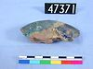
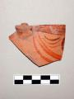
Finding/Filtering Europeana Objects
How to distinguish useful from "useless" objects?
Europeana has no notability criteria (ala Wikipedia)
All kinds of objects of only specialist interest have made their way into Europeana
E.g. half of "jar" objects are fragments/shards:
jar fragment from the Petrie Museum of Egyptian Archaeology (UCL)
cup fragment from the Fitzwilliam Museum, Cambridge, UK
Need to learn blacklist rules from user judgements

Slide 33
Candidate Datasets
Given this wide variety, where do we find classification concepts?

Slide 34
Non-FD-Specific Datasets
Places/Locations
GeoNames (9.5M), Getty TGN (1.2M), Wikipedia (0.85M)
People, Orgs
Wikipedia (3.7M), VIAF (33M), ULAN (part of VIAF), RKDartists…
Some FD people "not notable" yet ☹ e.g.
Matilde Balzan (Maltese TV Presenter): not even on https://mt.wikipedia.org
GLAM Object Types, materials, techniques
Getty AAT, Wikipedia

Slide 35
Thesauri of Content Partners
Survey asking content partners what thesauri they use:
CAG: Dutch AAT (Am-MovE), specialized local thes for agricultural objects
IAPH: own thesaurus available on the web
Wolverhampton: tried to use British Museum object thesaurus
RMCA: AAT
Horniman: own thesaurus (which one?)
VUFC: own thesaurus
The other partners do not use particular thesauri

Slide 36
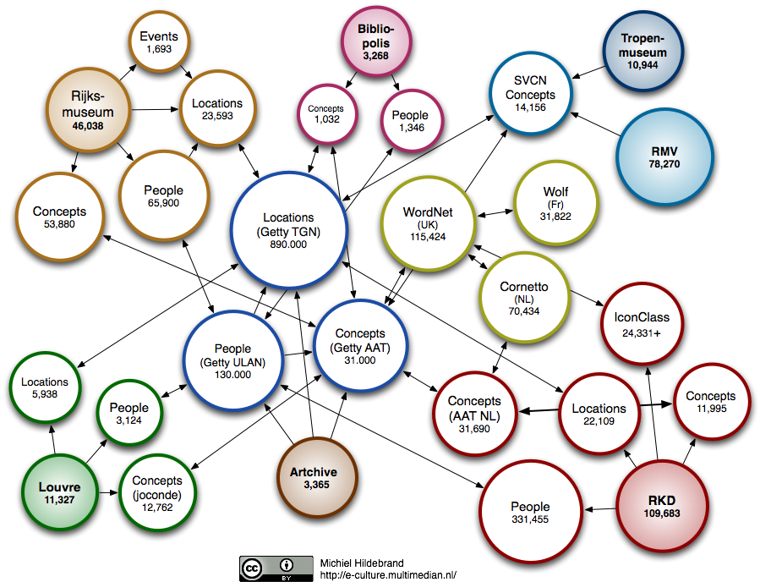
Getty Thesauri
AAT: 43k concepts, 307k labels (4 lang+). 7 facets (roots), 11 levels, good org
TGN: 1.2M places (0.8M North America)
ULAN: 235k persons/orgs
Highly used/referenced. "CH LOD cloud"
Published as LOD (by Onto) http://vocab.getty.edu

Slide 37
AAT FD-related
AAT id | Hierarchy | Items
300199765 | Culinary Equipment | 866
300024716 | <grinding and milling equipment> | 15
300254496 | Food | 85
300004332 | <eating and drinking spaces> | 19
300203437 | closures (container components) | 8
300006335 | food processing plants | 10
300120719 | beverage processing plants | 6
300069097 | feasts | 4
 | Total | 1013
1k FD is not bad, but is not enough
Fished out of several hierarchies, diminishing returns
Plenty of FD-independent concepts we can use (e.g. obj.types like Painting, cultures/style (over 5k)

Slide 38
British Museum Thesauri
About 20, published by LOD (by ONTO)
Not coreferenced, but started (Person-Org thes) on Wikidata Mix-n-Match
E.g. Obj Type: 5854, about 500 FD-related
URL | Concept
http://collection.britishmuseum.org/id/thesauri/x5112 | agricultural equipment
http://collection.britishmuseum.org/id/thesauri/x5113 | agricultural tool/implement
http://collection.britishmuseum.org/id/thesauri/x5413 | beer-bottle
http://collection.britishmuseum.org/id/thesauri/x5414 | beer-container
http://collection.britishmuseum.org/id/thesauri/x72562 | beer-dipper
http://collection.britishmuseum.org/id/thesauri/x5415 | beer-glass
http://collection.britishmuseum.org/id/thesauri/x5416 | beer-jug
http://collection.britishmuseum.org/id/thesauri/x5417 | beer-mug
http://collection.britishmuseum.org/id/thesauri/x5418 | beer-pot
http://collection.britishmuseum.org/id/thesauri/x5419 | beer-skimmer
http://collection.britishmuseum.org/id/thesauri/x5420 | beer-strainer
http://collection.britishmuseum.org/id/thesauri/x5421 | beer-trough
http://collection.britishmuseum.org/id/thesauri/x5422 | beer-vessel

Slide 39
UN FAO AgroVoc
Developed by Food and Agriculture Organization for 21 years
32k concepts, 21k languages
Coreferenced to US NALT and 12 other
Maintained with VocBench using ONTO GraphDB. Published as LOD (SKOS, SKOS-XL)
Emphasis on scientific and production side of food, not enough on consumption, fun and appreciation side

Slide 40
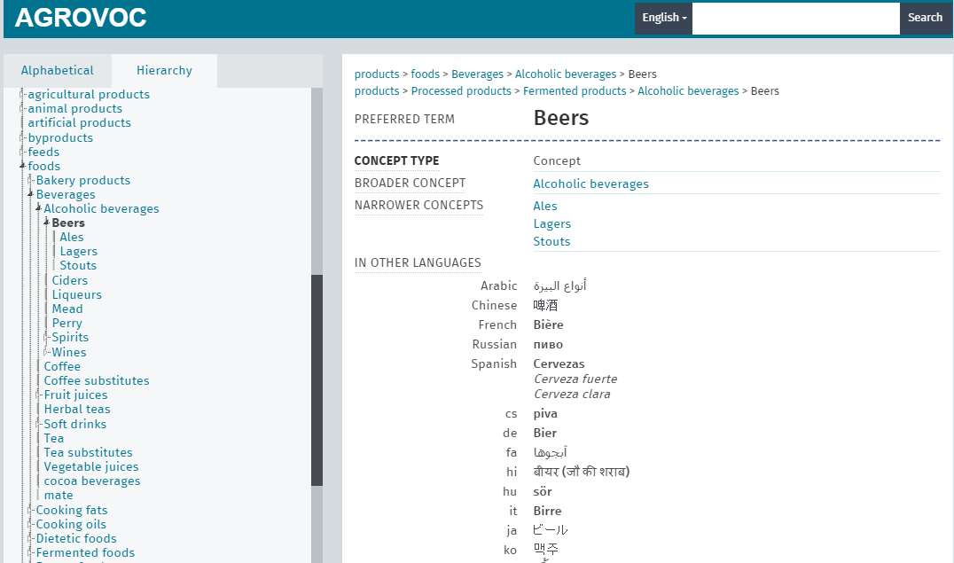
AgroVoc FD-related
E.g. 3 beers (AAT has none). But Wikipedia has, 25 Types (including Boza?), 50 styles, many brands, e.g. German beers.
Nothing on traditions, festivities, rituals, festivals, even silly things like drinking games

Slide 41
Wikipedia
Basic idea: Wikipedia as our playing field
Use Articles as classification concepts
Use superstructures (Lists and Categories) to discover FD-related and make a hierarchy
Big advantage: multilingual coverage
12.5M articles in EFD langs, 2.11 lang overlap → 5.9M "concepts". Of them 2.6M "things" in EFD langs with assigned DBpedia type
Wikipedia | URL | articles
English | http://en.wikipedia.org | 4,774,396
Dutch | http://nl.wikipedia.org | 1,804,691
French | http://fr.wikipedia.org | 1,579,555
Italian | http://it.wikipedia.org | 1,164,000
Spanish | http://es.wikipedia.org | 1,148,856
Polish | http://pl.wikipedia.org | 1,082,000
Bulgarian | http://bg.wikipedia.org | 170,174
Hungarian | http://hu.wikipedia.org | 272,323
Romanian | http://ro.wikipedia.org | 256,022
Lithuanian | http://lt.wikipedia.org | 168,823
Greek | http://el.wikipedia.org | 102,077
Total |  | 12,522,917

Slide 42
WP "Things" and Lang Overlap

Slide 43
Articles vs "Things"
enwiki:Mămăligă is the same as bgwiki:Мамалига
enwiki:Kačamak is the same as bgwiki:Качамак
But are the two the same or different?
How different is enwiki:Polenta from those two, really?
One or several articles exist according to various editorial decisions not considerations of "thesauristic completeness"
E.g. there's wiki:Mortar_and_pestle but no separate "Mortar" and "Pestle"
It's an encyclopedia not dictionary/thesaurus
Articles exist or not according to different "dynamics"
An important consideration is Notability: "delete wars"
We should also investigate Wiktionary but it has lower coverage (how much) and no such rich super-structure
FD-related articles: estimate 10-20% (590k-1.2M)
This is our "sense inventory" to work with

Slide 44
Wikipedia Categories
Wikipedia | articles | cats | art<cat | per art | per cat | cat<cat | per cat
English | 4,774,396 | 1,122,598 | 18,731,750 | 3.92 | 16.69 | 2,268,299 | 2.02
Dutch | 1,804,691 | 89,906 | 2,629,632 | 1.46 | 29.25 | 186,400 | 2.07
French | 1,579,555 | 278,713 | 4,625,524 | 2.93 | 16.60 | 465,931 | 1.67
Italian | 1,164,000 | 258,210 | 1,597,716 | 1.37 | 6.19 | 486,786 | 1.89
Spanish | 1,148,856 | 396,214 | 4,145,977 | 3.61 | 10.46 | 675,380 | 1.70
Polish | 1,082,000 | 2,217,382 | 20,149,374 | 18.62 | 9.09 | 4,361,474 | 1.97
Bulgarian | 170,174 | 37,139 | 387,023 | 2.27 | 10.42 | 73,228 | 1.97
Greek | 102,077 | 17,616 | 182,023 | 1.78 | 10.33 | 35,761 | 2.03
Subtotal | 11,825,749 | 4,417,778 | 52,449,019 | 4.44 | 11.87 | 8,553,259 | 1.94
Hungarian | 272,323
Romanian | 256,022
Lithuanian | 168,823
Total | 12,522,917
Every article categorized is by 4.44 categories ("art<cat"). Variation between languages is huge. plwiki a lot, itwiki quite little
Every cat is used 11.9 times. In nlwiki 29.2 times, so they have less discriminatory power
Last 3 languages: not on DBpedia so hard to count. ONTO hosts bg.dbpedia. Can host all DBpedias together (else fragmented are harder to query)
Another option is Wikidata but it doesn't have art<cat assignments

Slide 45
FD-related Categories
Category:nnnn
Food and drink (ROOT)
Beverages
Ceremonial food and drink
Christmas food
Christmas meals and feasts
Cooking utensils
Drinking culture
Eating parties
Eating utensils
Food and drink preparation
Food culture
Food festivals
Food services occupations
Foods
History of food and drink
Holiday foods
Meals
Works about food and drink
World cuisine
Interesting:
Metaphors referring to food and drink
Religious food and drink
Food law (e.g. halal, kashrut, designation of origin)
Food politics
Drink and drive songs
Food museums

Slide 46
FD-related Categories
E.g. wiki:Category:Food_museums leads to over 500 museums, including.
food, farm, mill, agriculture, beverage, beer, tea, chocolate...
wiki:Category:Salt_museums alone has 15 museums!!
Below root "Food and drink": 887k out of 4.8k or 18.5%
Indication of FD-related coverage of Wikipedia
Also relevant sibling: Nutrition

Slide 47
Cat Structure Problems
Every cat has 1.94 parents ("cat<cat"). That's hugely poly-hierarchical (AAT is 1.05)
Loops. "Cat Combing" algorithm to straighten it level by level (but what to do about loops at the same level)
It's a navigation structure not proper thesaurus. No guarantee of conceptual inclusion
Spillage into inappropriate cats

Slide 48
Cat Spillage and Half-relevance
Half-relevance
Animal_products(*)
Animal-based_seafood(+)
Dairy_products(+)
Eggs_(food)(+)
Animal_dyes(-)
Animal_hair_products(-)
Animal_waste_products(-)
Bird_products(-)
Bone_products(-)
Non-Human Food/Eating
Foods and drink includes animal feeding
e.g. Eating_behaviors(*)
Diets(+)
Eating_disorders(+)
Carnivory(-)
Detritivores(-)
Spillage:
Food_and_drink(+)
Food_politics(+)
Water_and_politics(?)
Water_and_the_environment(?)
Water_management(?)
Water_treatment(?)
Euthenics(-)
Personal_life(-)
Leisure(-)
Sports(-)
Sports_by_type(-)
Team_sports(-)
Football(-)
1000s of teams(-)

Slide 49
Cat Relevance Scoring
Blacklists of inappropriate cats
Start with descendants of root
Every time an article is used to classify:
Raise article score
Raise score of ancestors leading to root (other ancestors may be irrelevant)
Augments the classification with use

Slide 50
WP Lists, Portals, Projects
Additional means to find articles on a given topic
Lists are explicit, higher-quality but harder to manage (have to develop extractors)
FD-related list cats (is your head spinning yet?)
Food-related lists
Lists of foods
Lists of beverages
Lists about Oktoberfest
Alcohol-related lists
Lists of restaurants
Bibliographies of food‎
Dessert-related lists‎
Lists of restaurants‎
Lists of food television series episodes‎

Slide 51
FD-related Lists
A small sampling:
List_of_Christmas_dishes
List_of_culinary_fruits
List_of_culinary_herbs_and_spices
List_of_culinary_vegetables
List_of_edible_seeds
List_of_festivals
List_of_foods
List_of_meat_animals
List_of_micronutrients
List_of_sandwiches
List_of_types_of_seafood
Lists_of_beverages
Lists_of_festivals
Lists_of_prepared_foods
Lists_of_restaurants
Wine_festival#Festivals

Slide 52
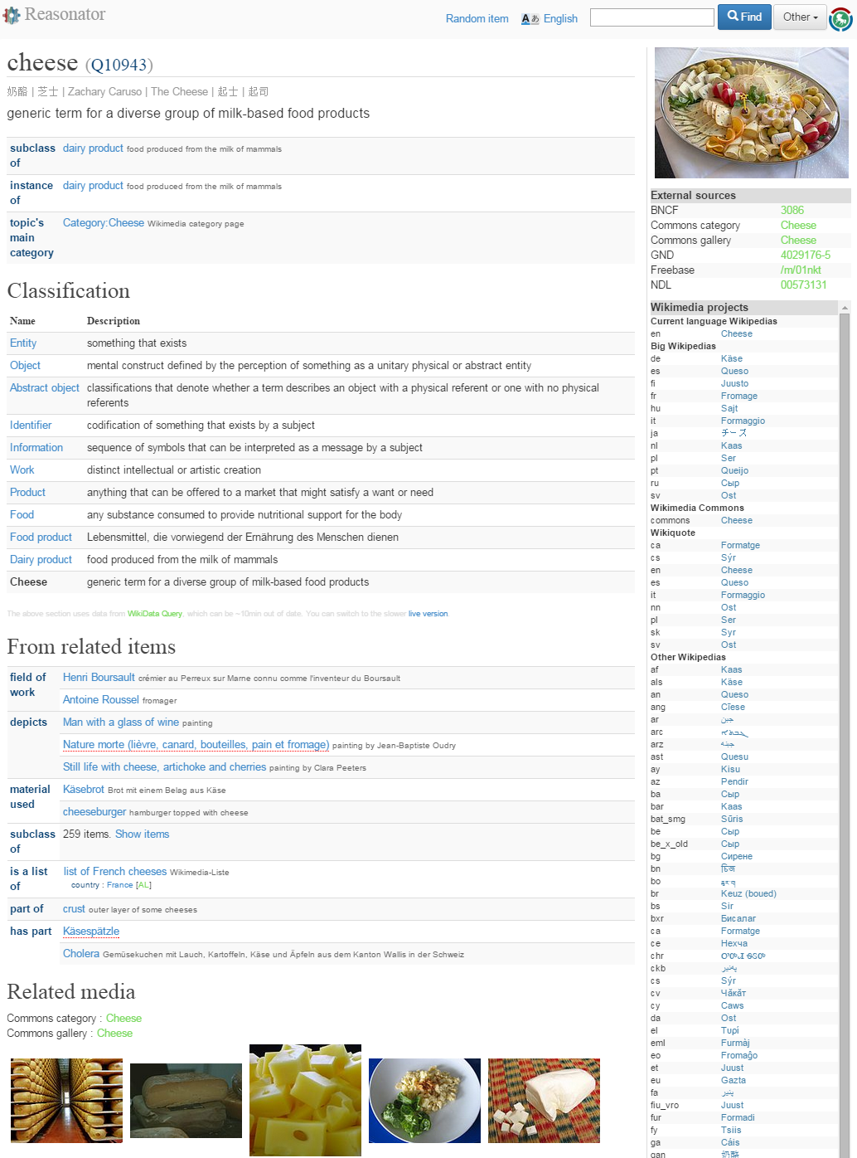
Wikidata
DBpedia and Wikidata are structured representations of part of Wikipedia info. E.g. "Cheese"

Slide 53
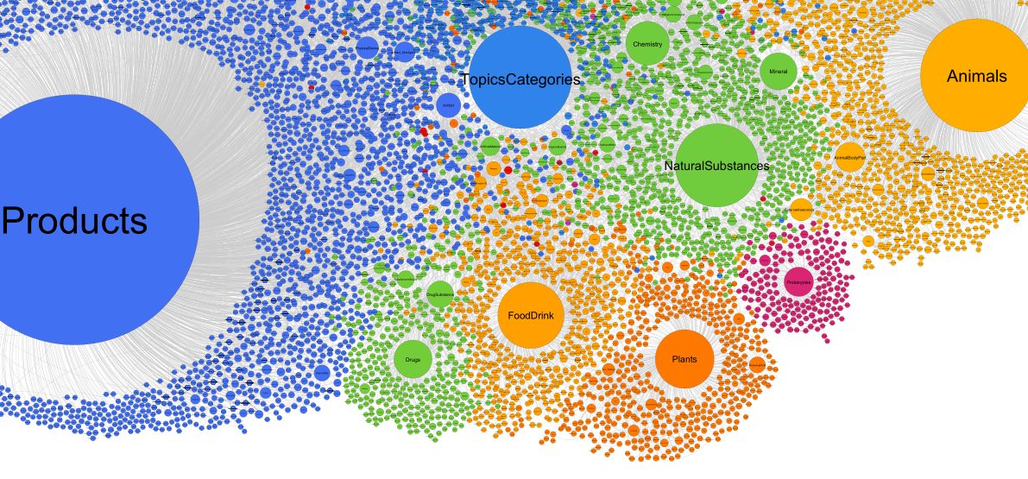
UMBEL FD SuperType
UMBEL classifies Wikipedia articles using part of OpenCyc (10%). 4y old. Bottom yellow part is FD (sizable).
Fished out 44k FD-related. Quite a catch but not enough to substitute working with categories

Slide 54
Sem App Tool Ideas

Slide 55
Automatic Enrichment
Use article names and aliases (redirect pages) as gazetteer (large-scale lookup)
Limit to FD-related cats:
Initially this selection will be limited (low recall) and include wrong cats (low precision)
Will improve with usage through human feedback
Use NLP techniques for major languages (we got NLP experience with en, nl, it, bg)
Enrich object (CHO) free text
Per-field for some (e.g. creator→persons/orgs, spatial→places)
Precise language indication is important
Dealing with ambiguity:
Use art & cat relevance scores to pick more relevant articles
Primary labels are matched with higher priority
Can we use context? Crucial for places (e.g. Guadalajara, Mexico vs Guadalajara, Spain)
For each occurrence provide candidate lists ranked by confidence

Slide 56
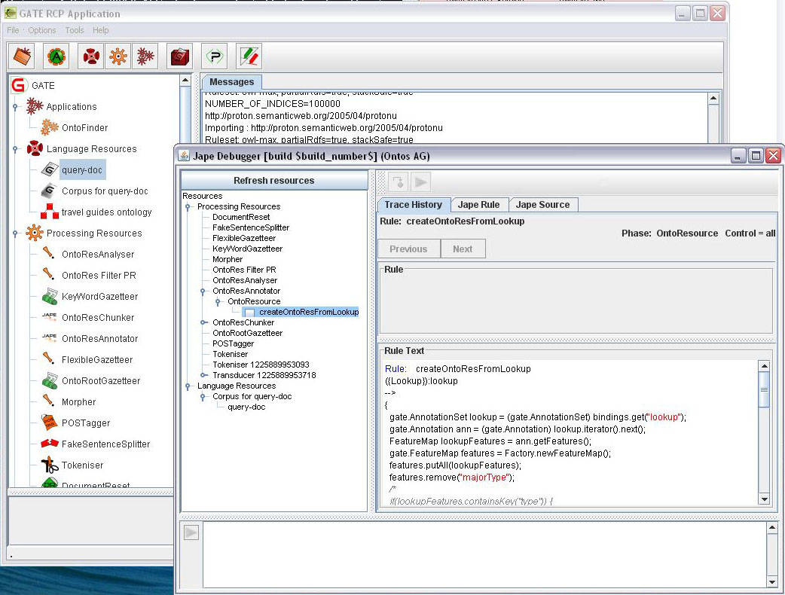
Developing with GATE & KIM

Slide 57
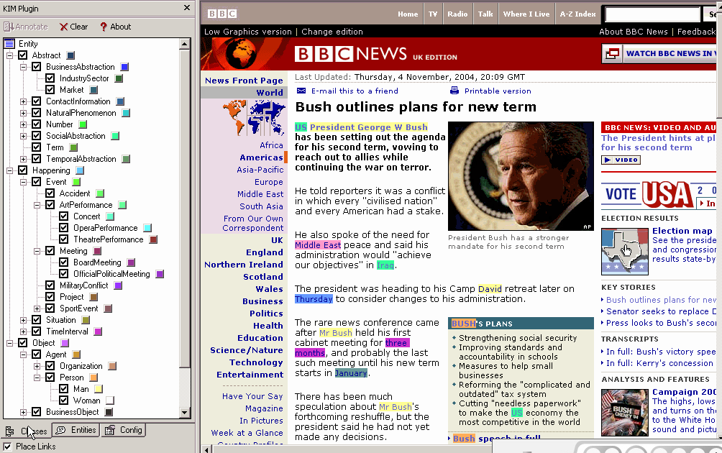
E.g. KIM Browser Plugin

Slide 58
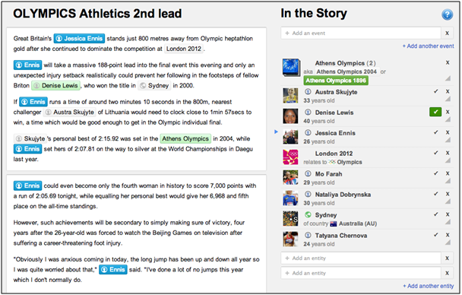
Manual Curation

Slide 59
Autocompletion
Efficient way to select a concept (article). Use:
Provider: to add or correct an object enrichment
Consumer: to select a concept (article) or category that has objects
Display:
Name
short description (first Wikipedia paragraph → DBpedia abstract )
Relevance score, number of objects, number of subcats, articles, inherited objects
Rank by relevance (e.g. number of uses)

Slide 60
Thesaurus Alignment
If a content partner uses a local (internal) thesaurus, how to bring it into the LOD cloud?
Better situation than no thesaurus, since concept alignment is easier than object enrichment
Alignment tools: SILK, LIMES, Amalgame…
Use string matching/similarity (e.g. Levenstein distance)
Some use concept "neighborhood" (context) for disambiguation
Manual adjustment step
Do content providers agree to use these tools?
ONTO will setup the tools but don't know the local languages, nor thesaurus-specifics

Slide 61
Visualizations
Purpose: facilitate understanding of the huge number of FD-related concepts (articles) and categories
Expand/collapse for browsing
Enable crowd-sourcing actions (e.g. confirm / blacklist cat branch)

Slide 62
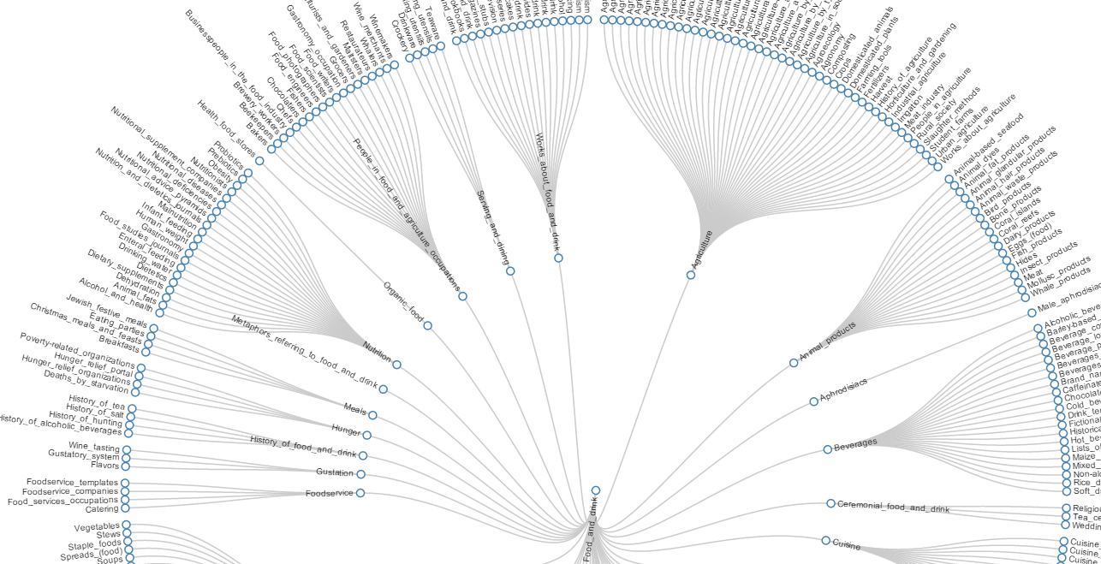
Radial Dendrogram
Interactive Radial Tree diagram

Slide 63
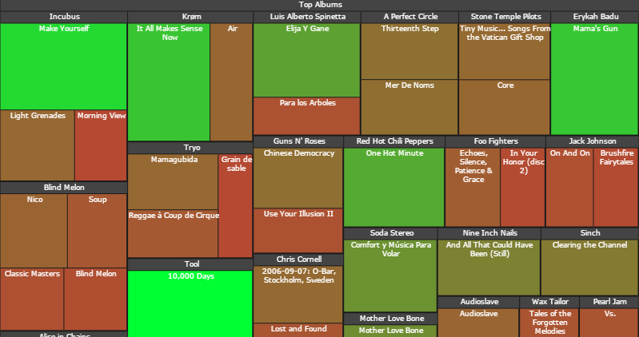
Tree Map

Slide 64
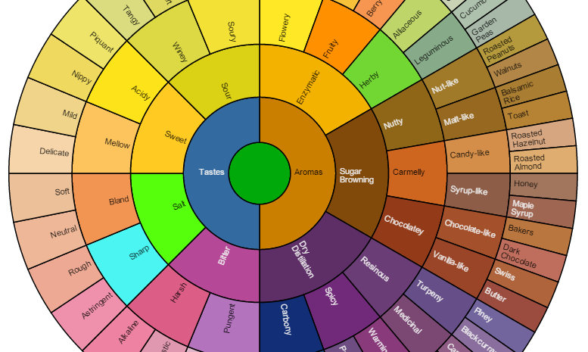
Sun-burst Diagram

Slide 65
Sem App Modules
Provider side
Submit object collection for enrichment
Curate automatic enrichment
Align thesauri
Select Europeana objects
Provide positive/negative examples
Consumer side
Semantic search: by person/org, place, event, concept (food, ingredient,
Geospatial search
Coreference (semantic facets), see next

Slide 66
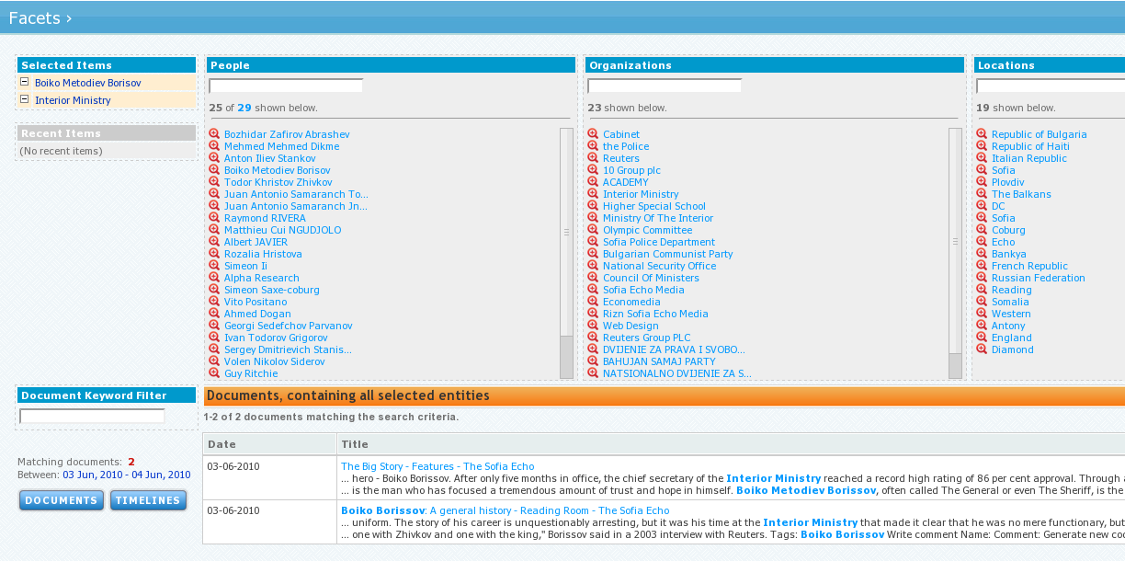
Semantic Facets

Slide 67
Positive Feedback Loop
Combination of Machine Learning and Crowdsourcing
Every human action to be leveraged through ML (ML probability model is adjusted incrementally)
User provides positive and negative examples
Machine learns relevant concepts and irrelevant (blacklisted) keywords
Using a concept augments its score and its parents score (like the brain learns through augmenting neuronal links)
The more the classification is used, the better it becomes

